Slide 1
CSCI-6234 ASSIGNMENT 3
UML
Team: CSCI 6234 – Team 9
Member: Binren Wang, Zhechao Wang, Zemao Song
GitHub Url: https://github.com/bbbbbw/CSCI6234_Project

Slide 2
ACTORS
Normal User: Elementary user of the system.
Group Member: Participants of a movie watcher group. Subclass of normal user.
Group Moderator: Organizer of a movie watcher group. Subclass of normal user.

Slide 3
USE CASES OF NORMAL USER
Create Group: Create a group
Join Group: Join a group

Slide 4
USE CASES OF GROUP MEMBER
Unsubscription: Unsubscribe from a group
Watch Trailer: Watch the trailer of the movies populated by the moderator
Pull Reviews: See movie reviews of the movies populated by the moderator
Pull Group Movie List: Search and browse the movies populated by the moderator
Vote For Event: Vote for the movies that they want / not want to watch in a movie watching event

Slide 5
USE CASES OF GROUP MODERATOR
Invitation: Invite people to join the group
Pull Movie List: Pull a movie list from a movie list server
Populate Group Movie List: Populate a group with a list of potential movies
Create Movie Watching Event: Create a movie watching event with a specified date and time
Create Voting Event: Open and close a voting period for a specific movie watching event

Slide 6
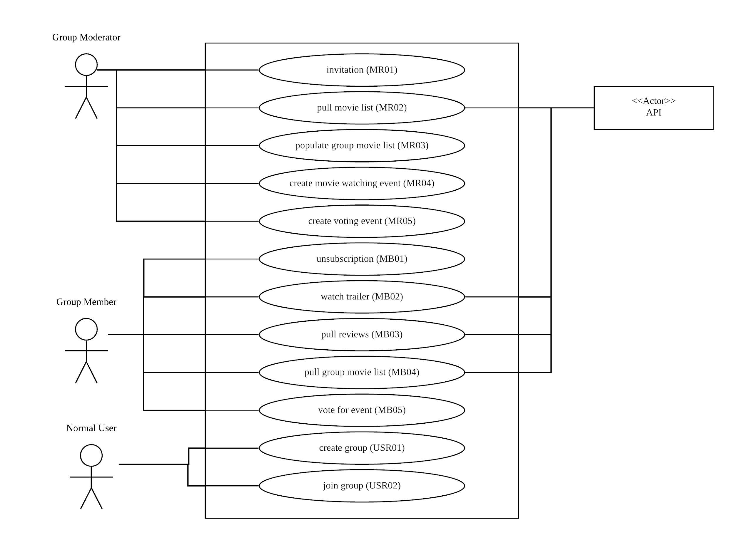
USE CASE DIAGRAM

Slide 7
USE CASE SPECIFICATION
Use Case ID | USR01 (USR stands for normal user)
Use Case Title | Create Group
Use Case Description | This use case describe how a normal user become a group moderator [Exception: Group name existed]
Pre-Condition | Have an account Successfully login
Post-Condition | User become a group moderator
Steps | User clicks ‘create group’ button System receives the request System displays the group register page User fills the required information in the page User clicks ‘create’ button System receives the info System checks duplicate, if no then next step, otherwise displays error and back to step 3 System displays new group main page

Slide 8
USE CASE SPECIFICATION
Use Case ID | USR02
Use Case Title | Join Group
Use Case Description | This use case describe the way how a normal user join a specific group [Exception: User already in the group]
Pre-Condition | Have an account Successfully login Have an invitation code
Post-Condition | User become a member of a specific group
Steps | User clicks ‘join’ button System receives the request System displays the group join page User enters the invitation code System receives code, searches the database and checks duplicate. If the code exists and is not used and user is not in the group, goes to the next step, otherwise, displays error and back to step 3 System adds user to the group, displays the group’s member main page and removes the invitation code from database

Slide 9
USE CASE SPECIFICATION
Use Case ID | MB01 (MB stands for group member)
Use Case Title | Unsubscription
Use Case Description | This use case describe how a group member unsubscribe from a group [Exception: User is moderator of the group]
Pre-Condition | Have an account Successfully login Joined a group On the member main page
Post-Condition | User leaves a specific group
Steps | Group member clicks ‘unsubscribe’ button System receives the request System displays the confirm page Group member clicks ‘continue’ button System receives the confirmation and removes the user from the group member list in database System returns a success result

Slide 10
USE CASE SPECIFICATION
Use Case ID | MB02
Use Case Title | Watch Trailer
Use Case Description | This use case describe how a group member watches the trailer of a certain movie populated by the group moderator
Pre-Condition | Have an account Successfully login Joined a group On a specific movie page
Post-Condition | System pops out a video window
Steps | Group member clicks ‘trailer’ button the on the page of a movie populated by the group moderator System receives the request System pops out the trailer video window of the movie and starts playing

Slide 11
USE CASE SPECIFICATION
Use Case ID | MB03
Use Case Title | Pull Reviews
Use Case Description | This use case describe how a group member see the reviews of a certain movie populated by the group moderator
Pre-Condition | Have an account Successfully login Joined a group On a specific movie page
Post-Condition | System displays movie reviews
Steps | Group member goes to the ‘review’ section of the page of a movie populated by the group moderator System receives the request System displays the reviews of the movie in the section

Slide 12
USE CASE SPECIFICATION
Use Case ID | MB04
Use Case Title | Pull Group Movie List
Use Case Description | This use case describe how a group member search and/or browse the movie list populated by the group moderator[Exception: Movie name not exist]
Pre-Condition | Have an account Successfully login Joined a group On the member main page
Post-Condition | System displays required movies in the movie list
Steps | Group member clicks ‘movie list’ button System receives the request and pops out the whole movie list populated by the group moderator Group member could enter keywords and click ‘search’ button System receives the request and pops out part of movie list according to the keywords provided by the group member

Slide 13
USE CASE SPECIFICATION
Use Case ID | MB05
Use Case Title | Vote For Event
Use Case Description | This use case describe how a group member votes for movies they want and do not want to watch in a specific movie watching event created by the moderator [Exception: Not valid voting period]
Pre-Condition | Have an account Successfully login Joined a group On the member main page At least an active
Post-Condition | System records the votes
Steps | Group member clicks ‘active event’ button of the page System receives the request and pops out all the events created by the moderator which member could vote for Group member clicks a certain event System receives the request and displays the voting area for the event consists of the movie list Group member clicks ‘for’ or ‘against’ button of one or more movies System receives the request, records the voting result into database

Slide 14
USE CASE SPECIFICATION
Use Case ID | MR01 (MR stands for group moderator)
Use Case Title | Invitation
Use Case Description | This use case describe how group moderator generate an invitation hash code, so that moderator can give it to someone let them join his/her group
Pre-Condition | Have an account Successfully login User is a group moderator
Post-Condition | New invitation code for this group generated
Steps | Group moderator opens its group manage page Group moderator clicks ‘invite’ button System receives the request System generates a new hash code for invitation, adds it to the database, and displays the hash code for copy

Slide 15
USE CASE SPECIFICATION
Use Case ID | MR02
Use Case Title | Pull Movie List
Use Case Description | This use case describes the process how moderator can get a movie list, that moderator can pick some movies to populate the group list [Exception: No search result found]
Pre-Condition | Have an account Successfully login Moderator is on the group manage main page
Post-Condition | Moderator see a clickable movie list
Steps | Moderator clicks ‘+’ button System receives the request and displays a search bar and a ‘generate’ button Moderator clicks ‘generate’ button System receives the request and requests a list of movies by popularity from API System handles the received data, and displays them as a clickable list for moderator Moderator enter a key word in search bar, and click ‘search’ button System receives request, and requests a list of movies by the keyword movie search from API System handles the received data, and displays them as a clickable list for moderator

Slide 16
USE CASE SPECIFICATION
Use Case ID | MR03
Use Case Title | Populate Group Movie List
Use Case Description | This use case describes the method how moderator can add a movie to the group list. So after that, all group members can see that movie information on group member page.[Exception: Movie already existed in the group list]
Pre-Condition | Have an account Successfully login A movie list is displayed
Post-Condition | A new movie is in the group list
Steps | Moderator clicks a movie in the movie list System receives the request, displays the movie information Once moderator finds a movie preferred, clicks ‘add’ button System receives the request, adds the movie information into the database These steps can be done multiple times until moderator closes the movie list

Slide 17
USE CASE SPECIFICATION
Use Case ID | MR04
Use Case Title | Create Movie Watching Event
Use Case Description | This use case describes how moderator can start a movie watch event. So all group member can see it in their member page and go to the theater at that moment
Pre-Condition | Have an account Successfully login On the main group manage page
Post-Condition | A movie watching event start
Steps | Moderator clicks ’watch event’ button System receives request, and displays a window asking moderator to fill the event date and time Moderator fills the information and clicks ‘create’ button System receives request, and adds the event to the database

Slide 18
USE CASE SPECIFICATION
Use Case ID | MR05
Use Case Title | Create Voting Event
Use Case Description | This use case describes how moderator can start a movie voting event. Once a voting event starts, all group member can see it and join the event. And the event history will be recorded and available for review to all group members. [Exception: Watching event not valid]
Pre-Condition | Have an account Successfully login On the main group manage page
Post-Condition | An active movie voting event starts
Steps | Moderator clicks ‘create voting event’ button System receives the request, and display a window ask moderator to fill the event information Moderator clicks ‘+’ button in the window System receives the request, display the search bar Moderator enters the keyword in the search bar, and clicks the ‘search’ button System receives the request, and request movie data via keyword movie search from API System handles the data, and display the list of movies as search result under the search bar Moderator clicks ‘+’ near the movie name to add it to the event movie list Search process can be done multiple time until moderator closes the search bar Moderator selects the event start time, end time and the related movie watching event Moderator clicks ‘start’ button System receives the requests, and adds the event to the database

Slide 19
BI-DIRECTION TRACEABILITY MATRIX
See Next Slide

Slide 20
Required Feature No | Required Feature Description | Use Case ID | Use Case Title
1 | The system shall allow a group moderator to create a movie watcher’s group. | USR01 | Create Group
2 | The system shall allow the moderator to invite family and friends to join the group. | MR01 | Invitation
3 | The system shall allow friends and family to join a group of movie watchers. | USR02 | Join Group
4 | The system shall allow people to unsubscribe from movie watcher’s groups. | MB01 | Unsubscription
5 | The system shall allow the moderator to populate movie watcher’s groups with a list of potential movies that could be watched. | MR03 | Populate Group Movie List
6 | The system shall allow the moderator to pull a movie list from a movie list server/API. | MR02 | Pull Movie List
7 | The system shall allow group members to search and browse the movies that have been populated by the moderator. | MB04 | Pull Group Movie List
8 | The system shall allow group member to watch the trailer of the movies that have been populated by the moderator. | MB02 | Watch Trailer
9 | The system shall allow group members to have access to movie reviews of the movies that have been populated by the moderator. | MB03 | Pull Reviews
10 | The system shall allow the moderator to create a movie watching event that will occur in the specified date and time defined by the moderator. | MR04 | Create Movie Watching Event
11 | The system shall allow the moderator to open and close a voting period for a specific movie watching event. | MR05 | Create Voting Event
12 | The system shall allow participants of a movie watcher group to be notified that a movie watching event was created and that they can vote for the movies that they want (or do not want) watch in this movie watching event. | / | /
13 | The system shall allow group participants to cast their votes where they indicate what movies they want and do not want to watch in a specific movie watching event previously created by the moderator. | MB05 | Vote For Event
14 | The system shall keep the history of movie watching events, votes, and winners for each movie watching group. This information shall only be available for the participants of the movie watching group. | / | /
15 | The system shall elect a single movie winner for a movie watching event based on the votes casted by the movie watcher group. | / | /
16 | The system shall not allow participants of a movie watching group to change their votes AFTER the system computed the winner movie based on casted votes. | / | /

Slide 21
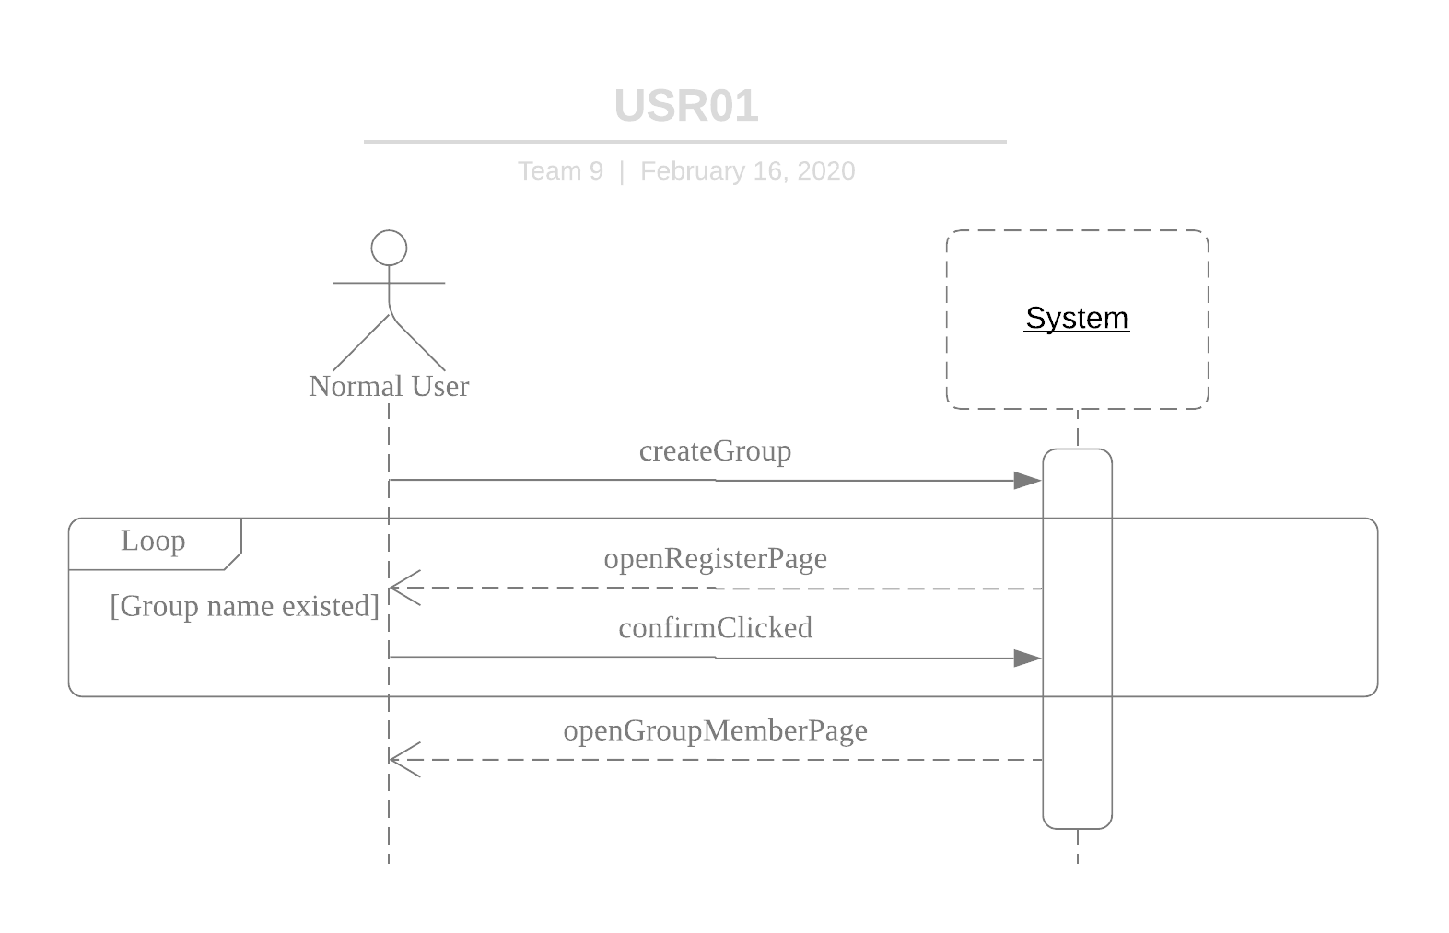
SEQUENCE DIAGRAM

Slide 22
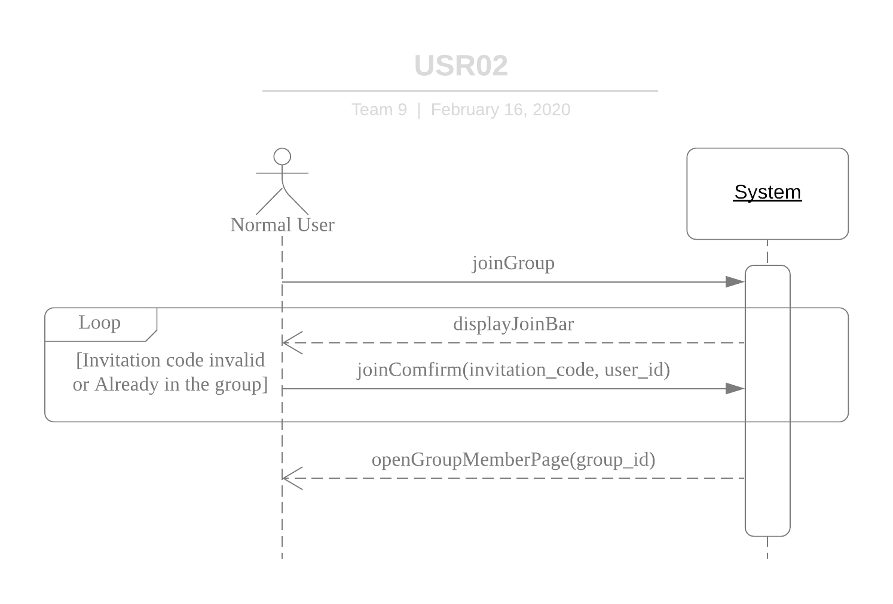
SEQUENCE DIAGRAM

Slide 23
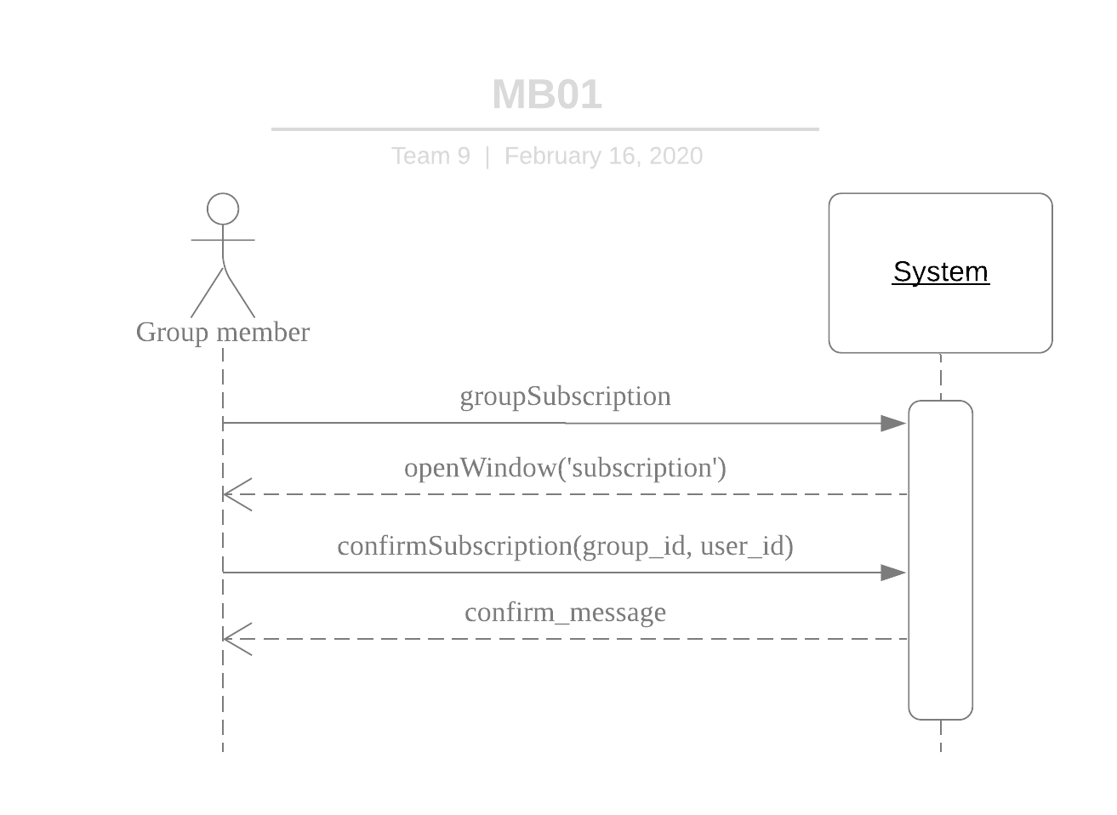
SEQUENCE DIAGRAM

Slide 24
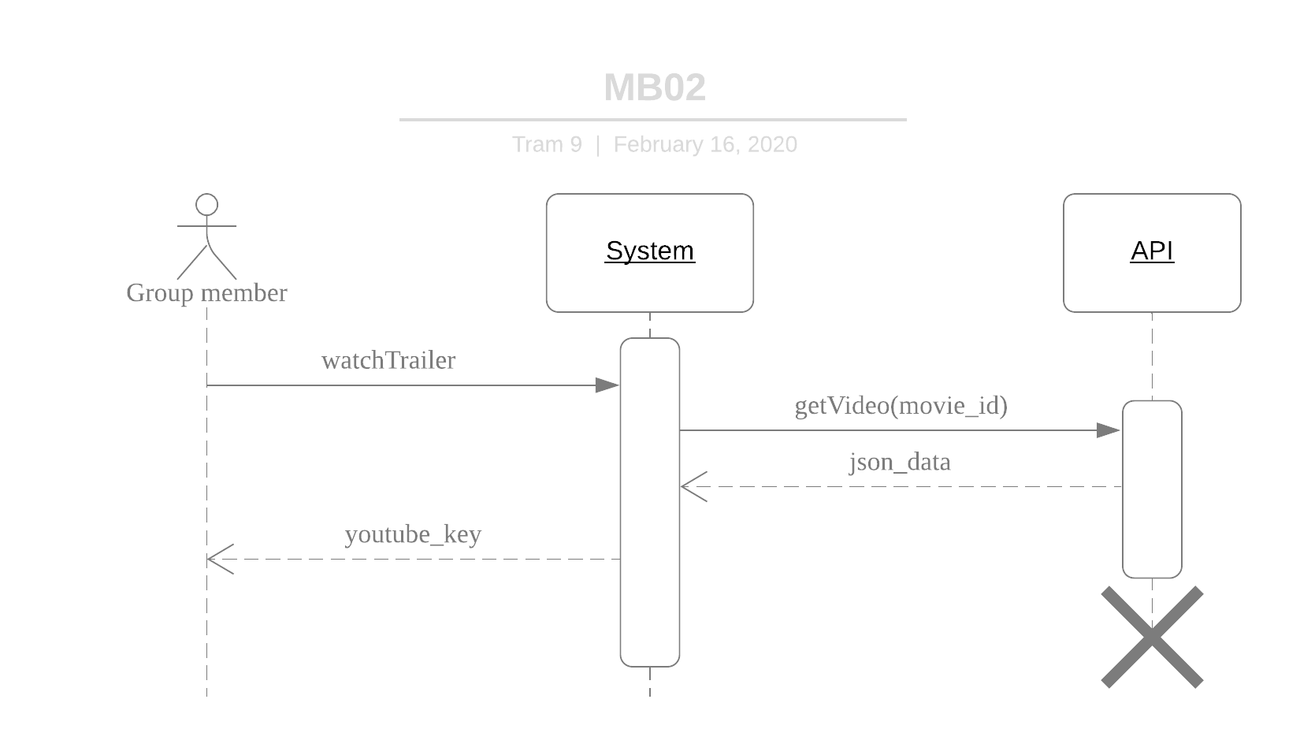
SEQUENCE DIAGRAM

Slide 25
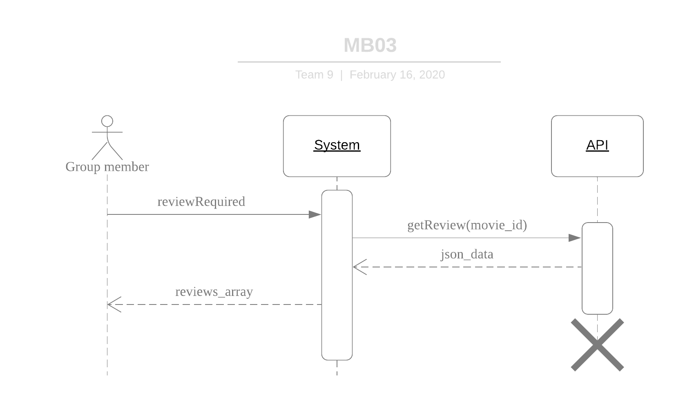
SEQUENCE DIAGRAM

Slide 26
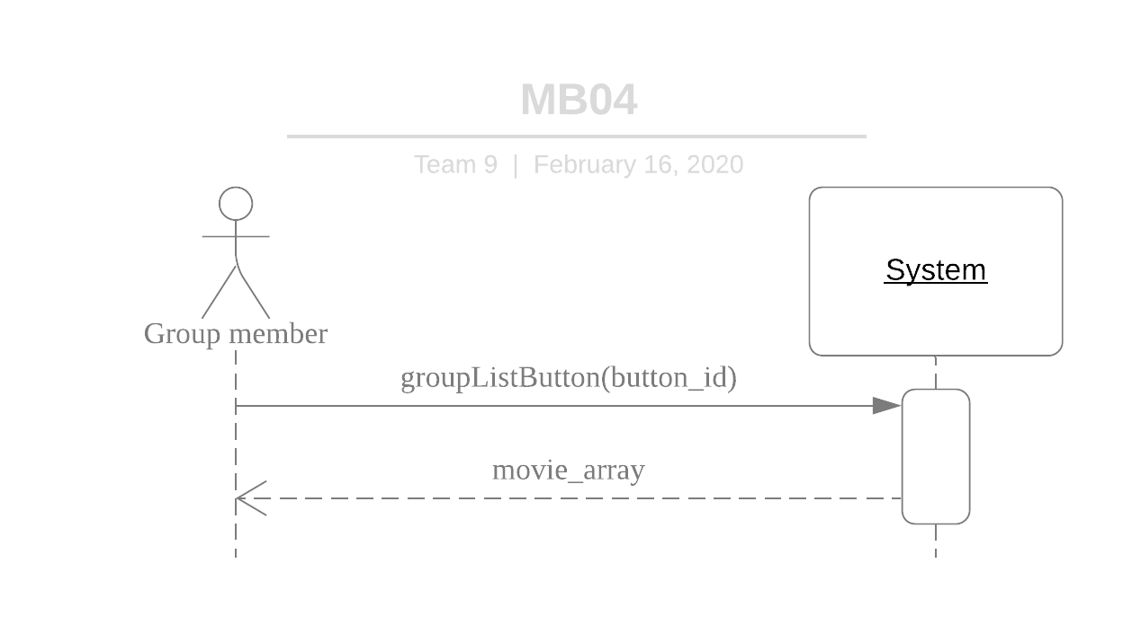
SEQUENCE DIAGRAM

Slide 27
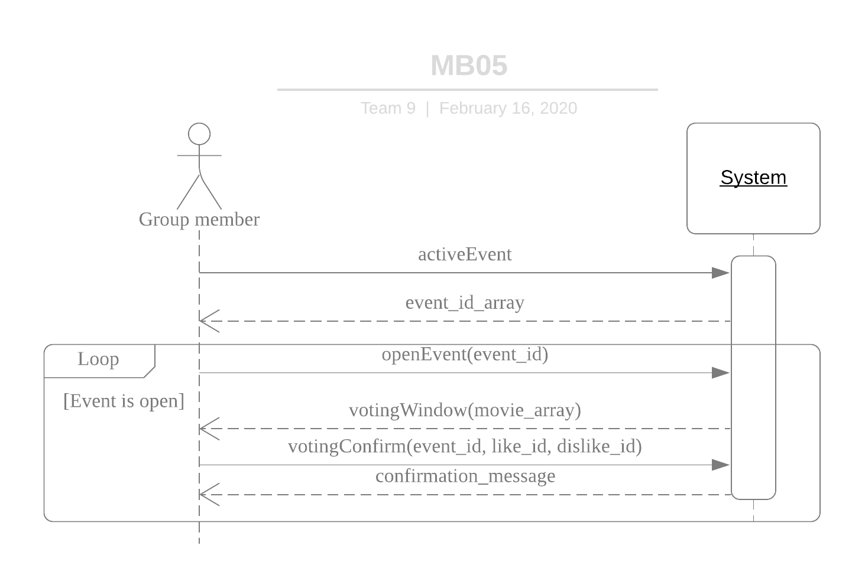
SEQUENCE DIAGRAM

Slide 28
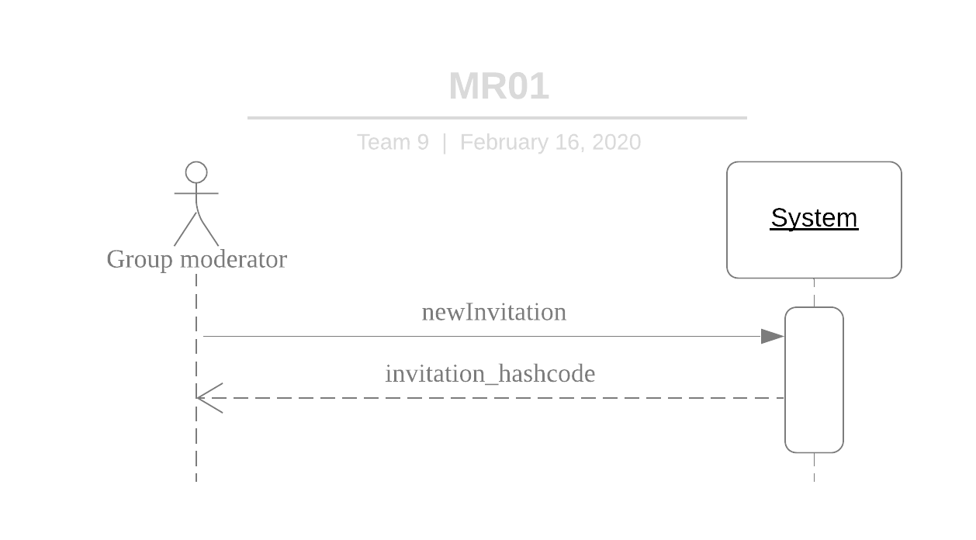
SEQUENCE DIAGRAM

Slide 29
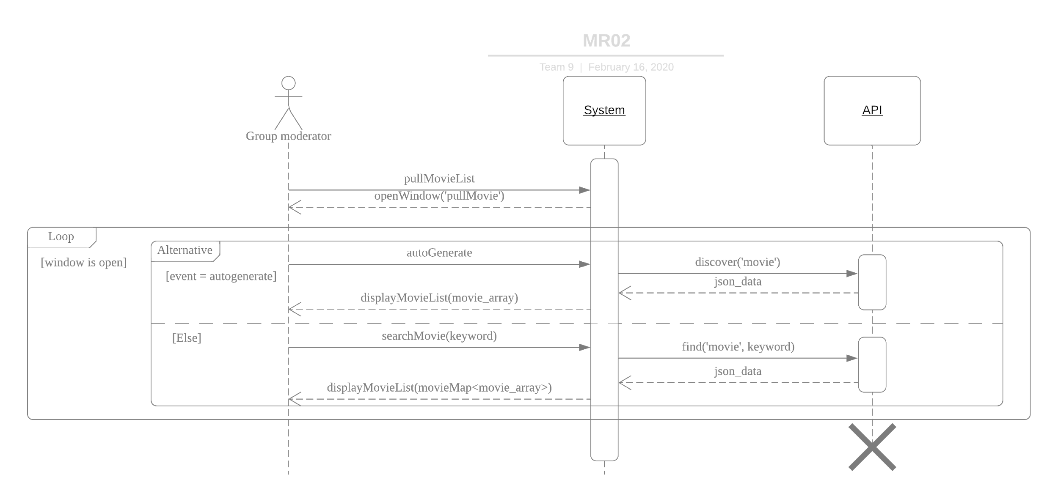
SEQUENCE DIAGRAM

Slide 30
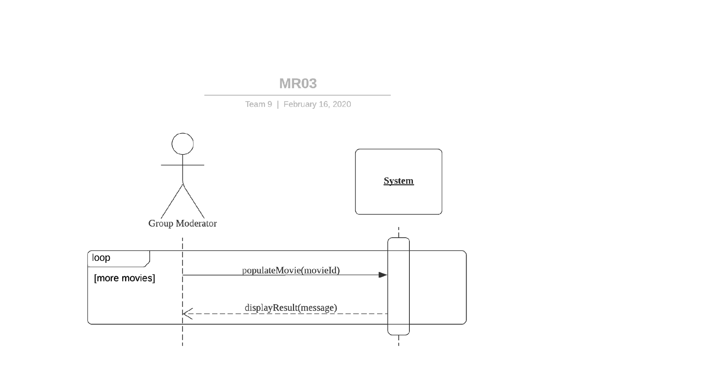
SEQUENCE DIAGRAM

Slide 31
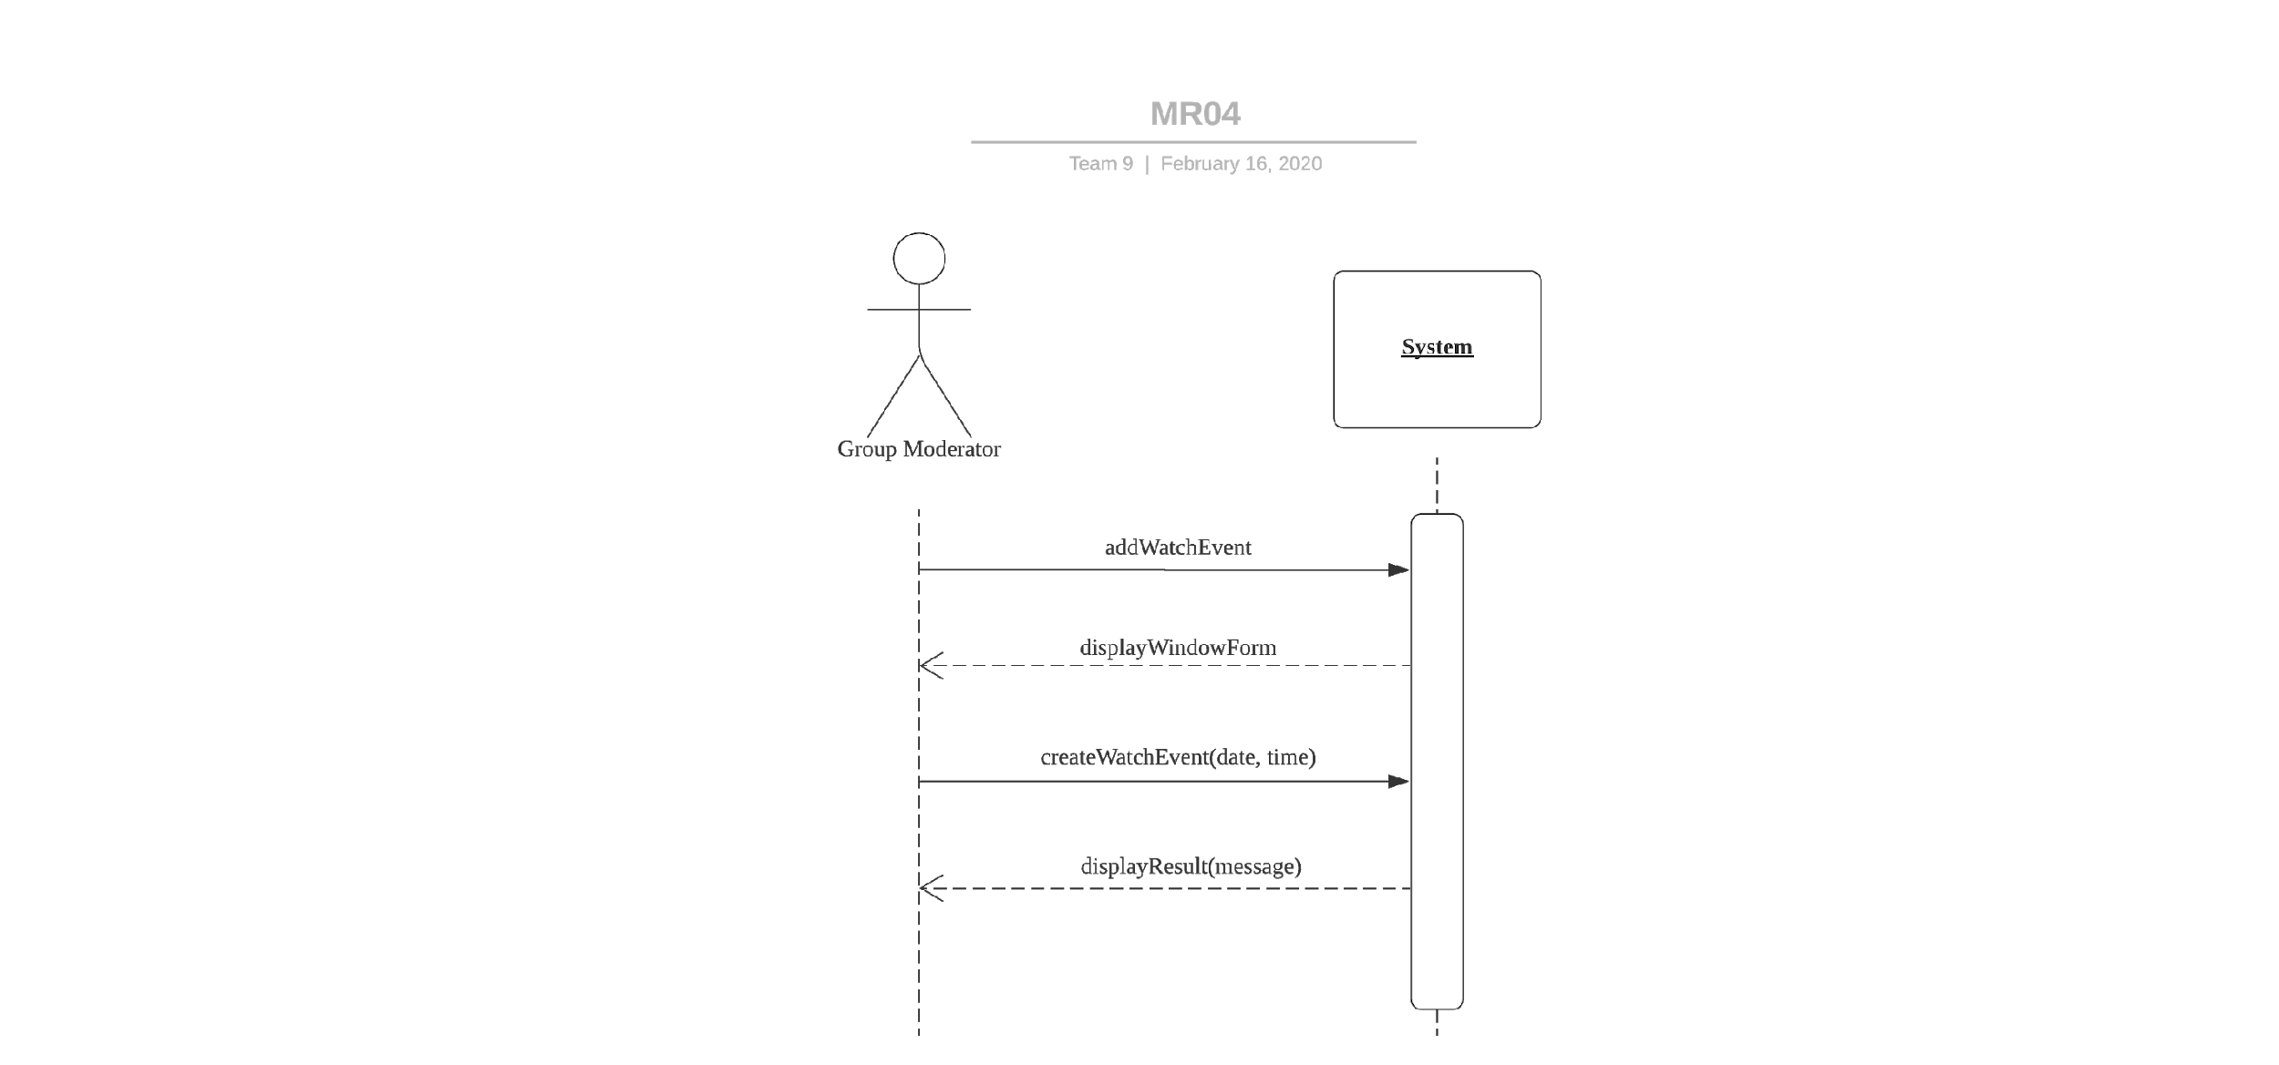
SEQUENCE DIAGRAM

Slide 32
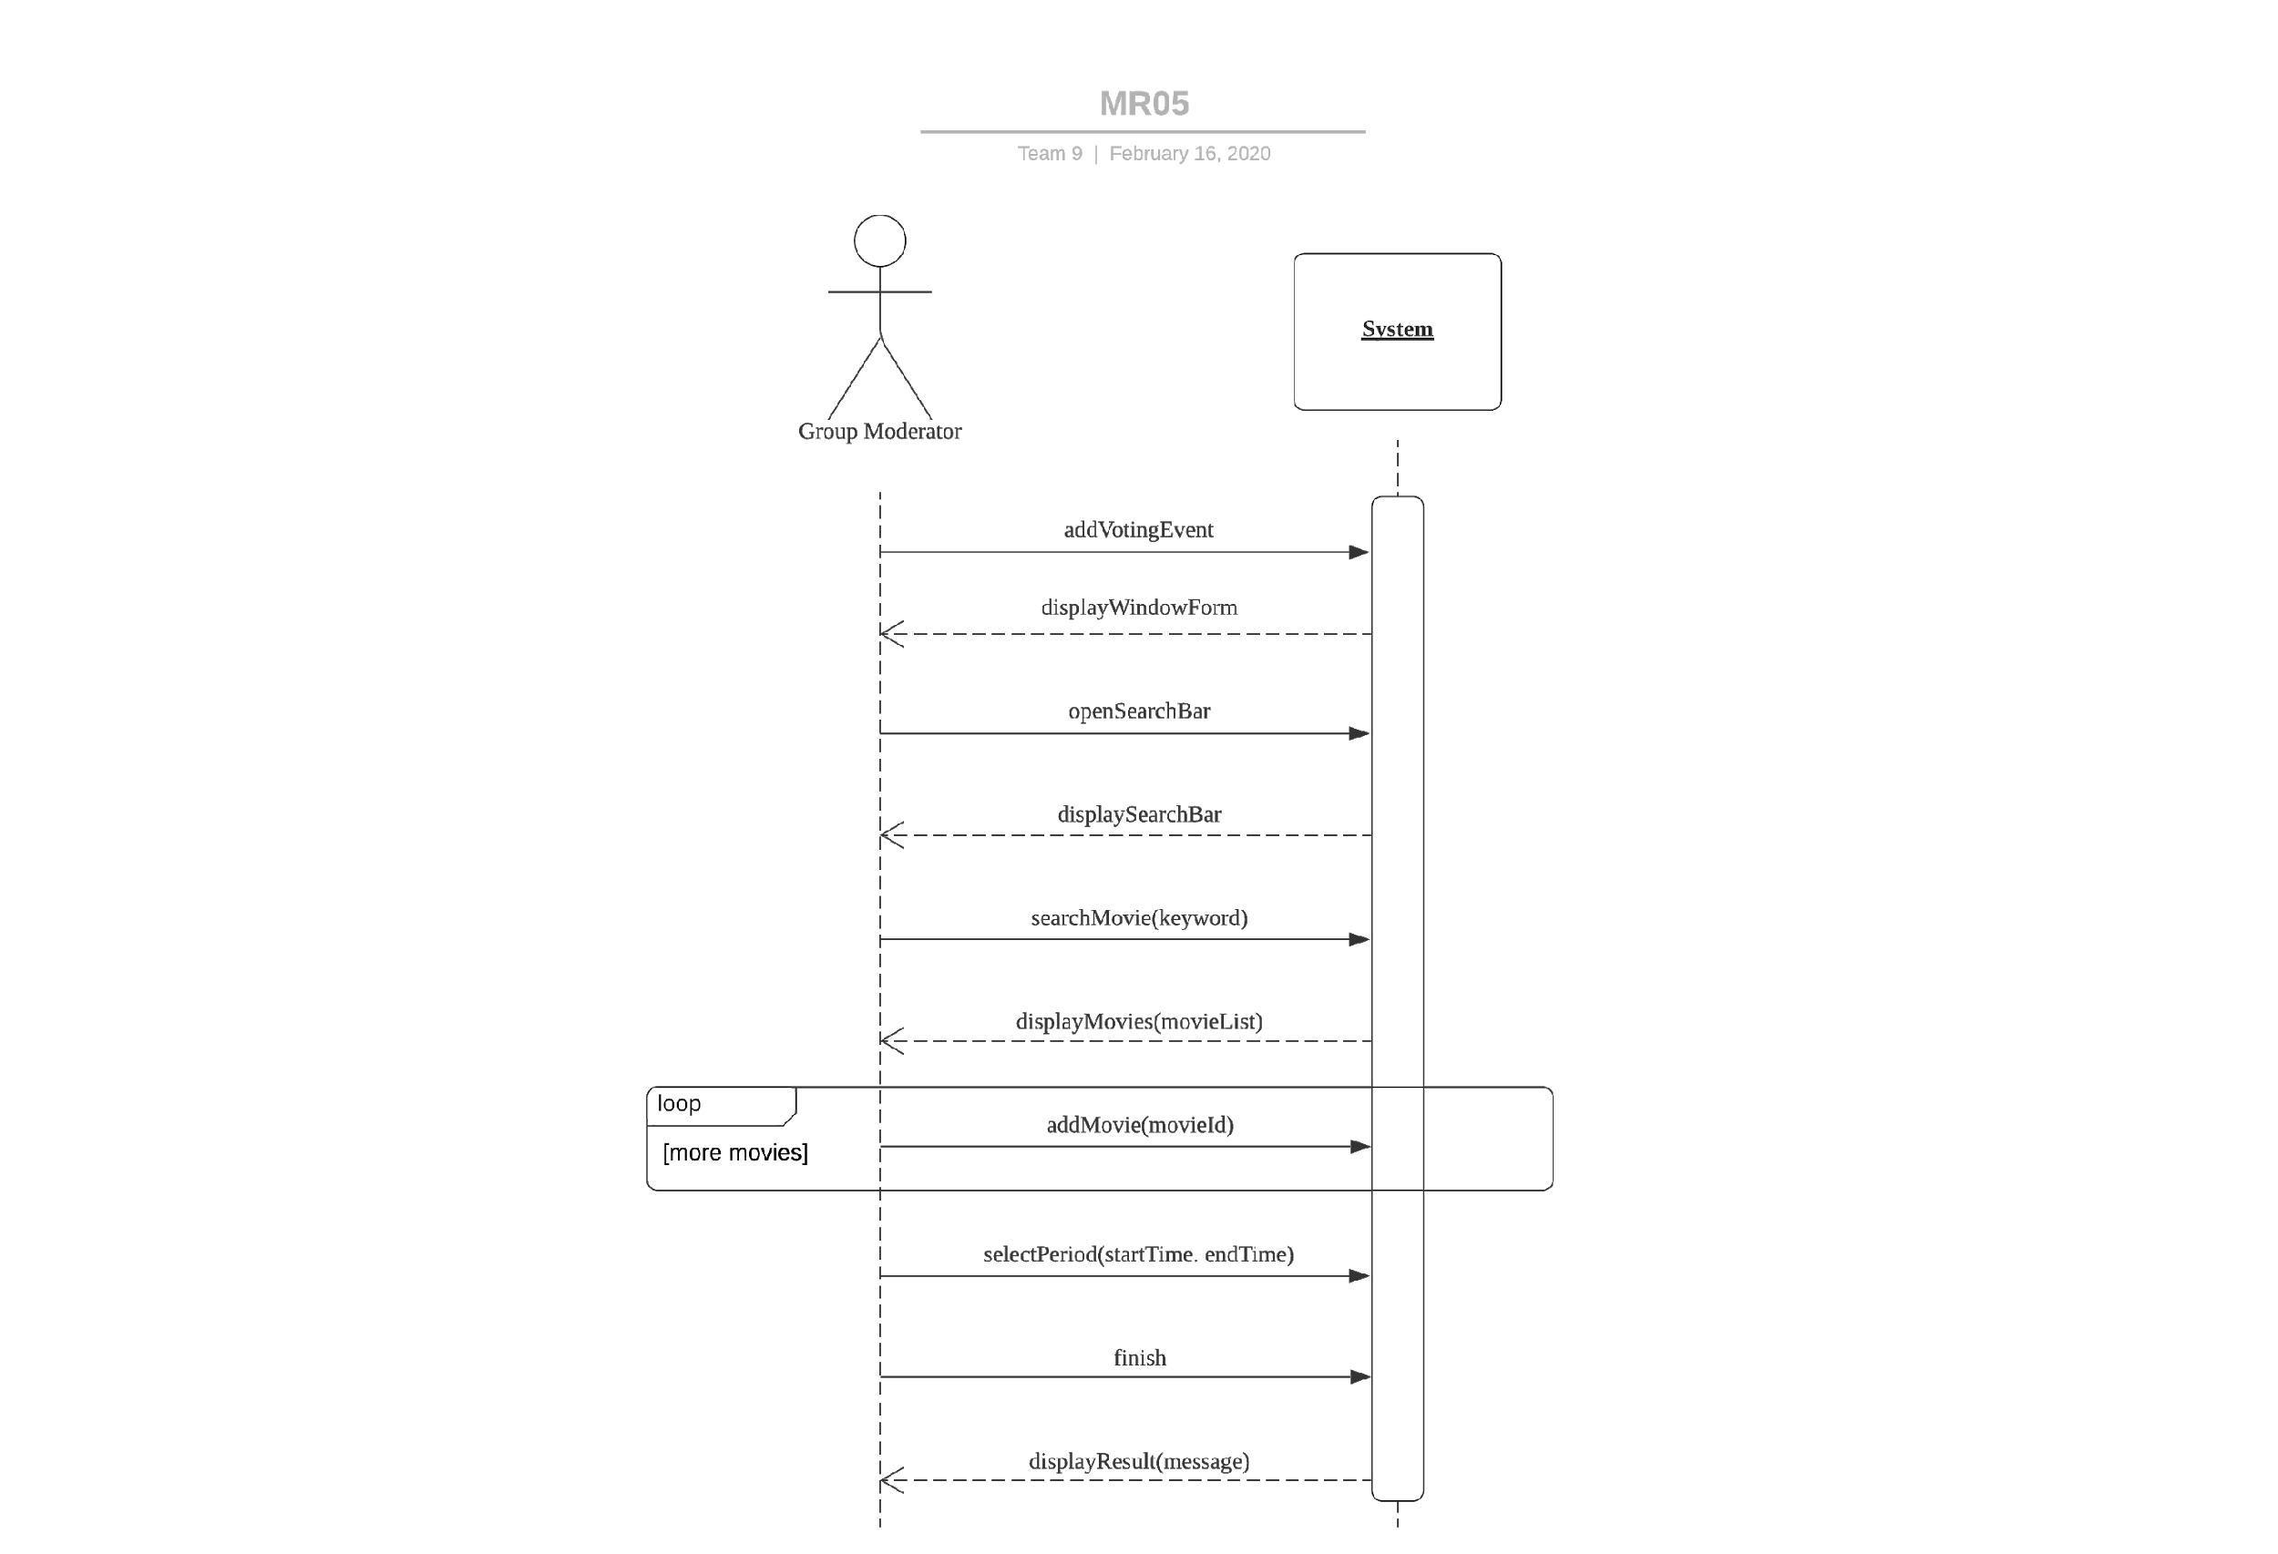
SEQUENCE DIAGRAM

Slide 33
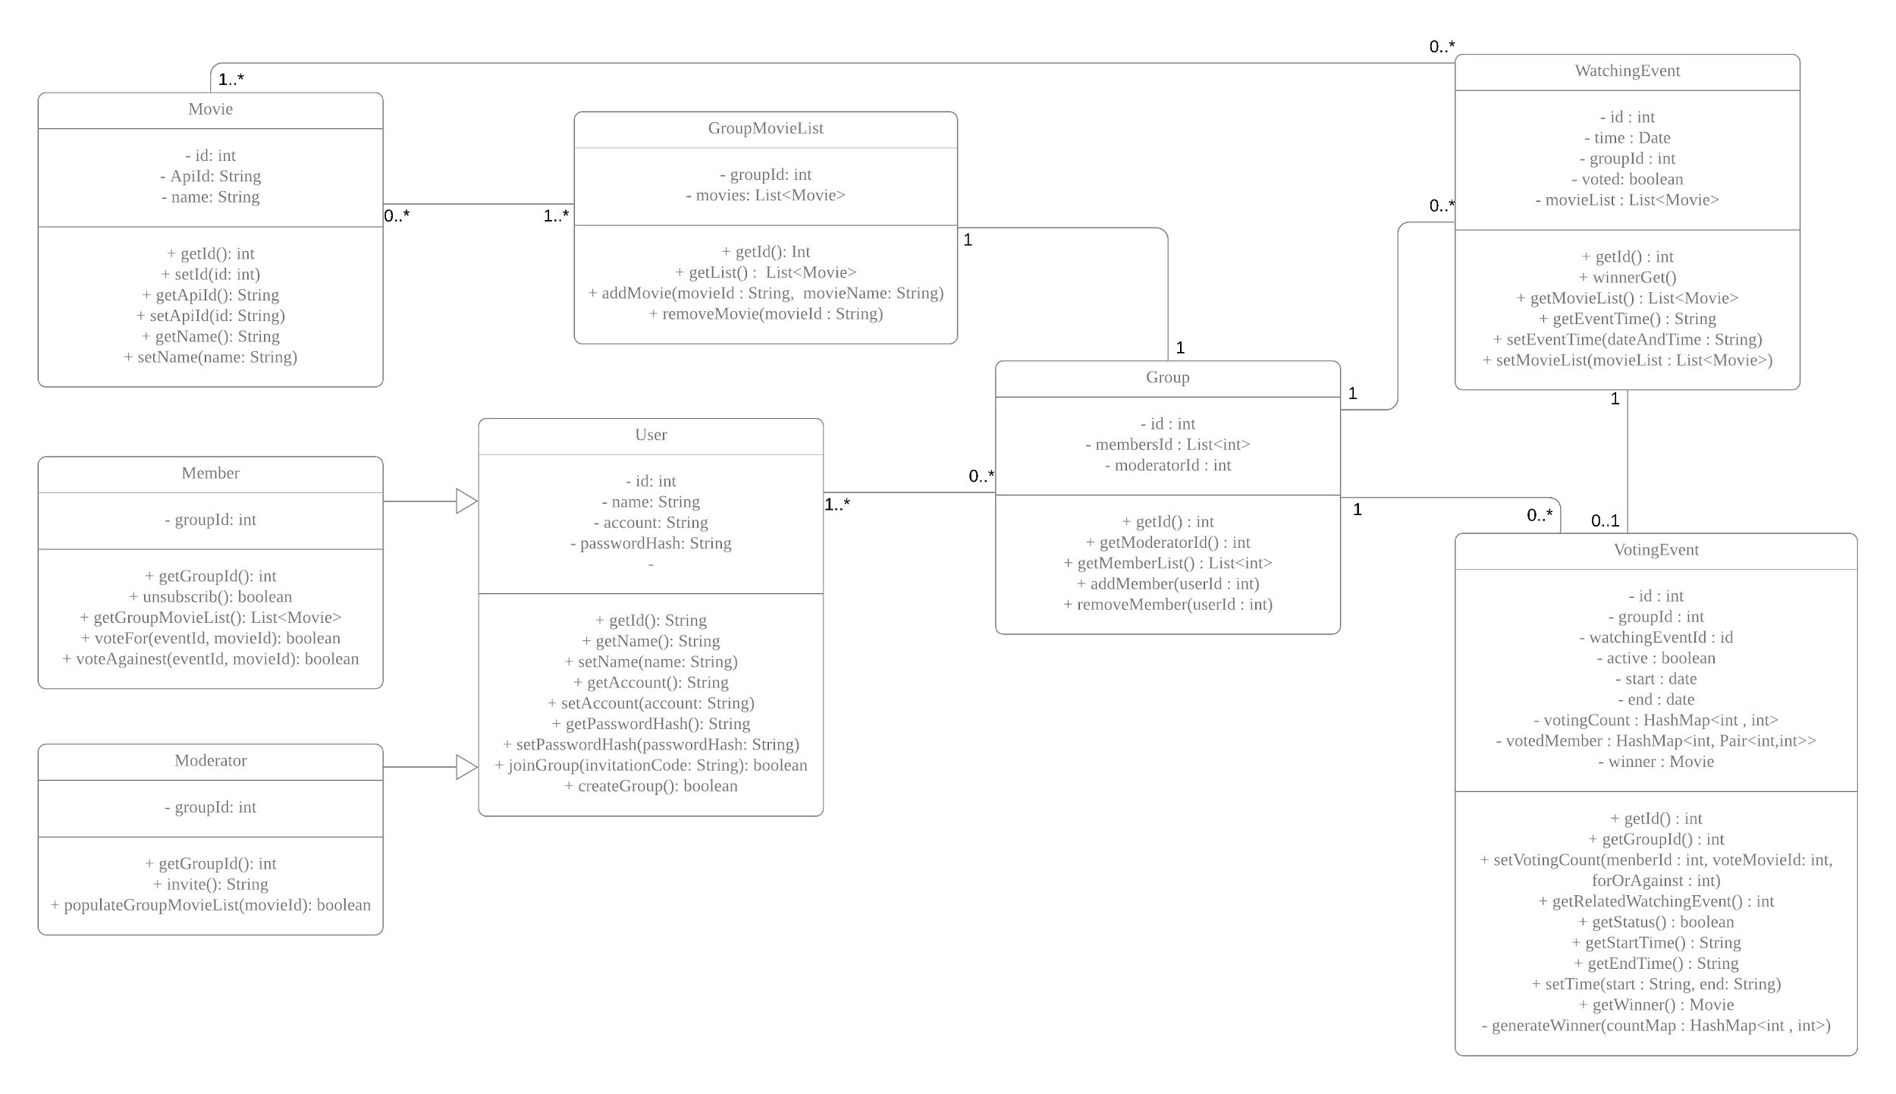
CLASS DIAGRAM

Slide 34
CLASS DIAGRAM
User: Elementary user of the system.
Member: Member of a group. Sub-class of User.
Moderator: Moderator of a group. Sub-class of User.
Group: A movie watcher’s group with one moderator and multiple members.
Movie: Movie data.
GroupMovieList: The movie list populated by moderator in each group.
WatchingEvent: The movie watching event create by moderator.
VotingEvent: The voting event corresponding to a certain movie watching event.

Slide 35
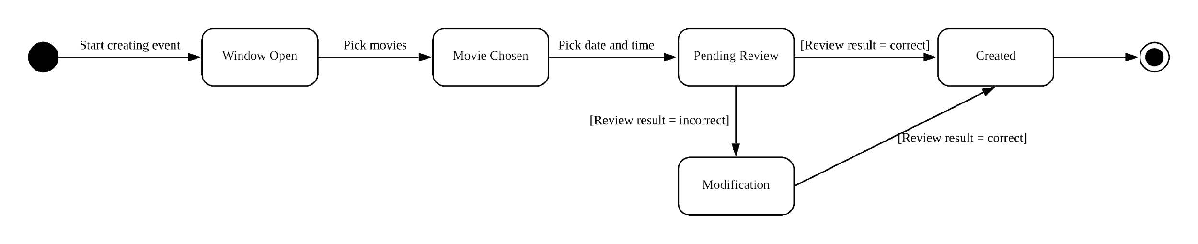
STATE DIAGRAM OF MOVIE WATCHING EVENT

